Slide 1
Lecture 5: Bayesian Inference & Regression

Slide 2
Recall our coin last time
It was allegedly magic, and we didn’t know if it would produce heads at a frequency different from a standard, fair coin
We used MLE to estimate the true probability, θ*, of it producing heads on any given flip
  The chances of it producing tails is 1-θ*
  The observed frequency/estimated probability of heads is θ
  The number of heads was represented as k, the number of flips, n
  Therefore, there are n-k tails

Slide 3
Our “magic” coin – prior probabilities
A prior probability is a probability assessed before you make any relevant observations
Sounds useless from the definition, but is fundamentally important for many, many applications
  Probability of a person at Connecticut College being female?
  Probability that a coin from my pocket lands on heads when I flip it?
  Probability that a piece of DNA codes for a gene?
  Note that you can make observations that may make you change your mind about each of these

Slide 4
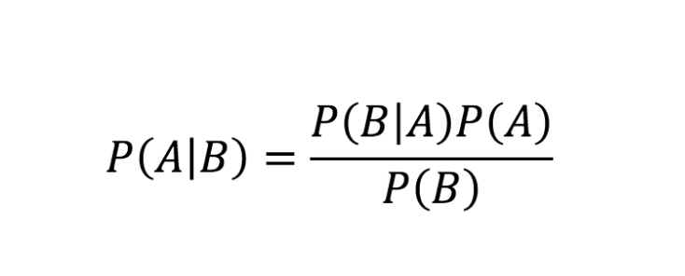
An (important) aside: Bayes rule

Slide 5
An (important) aside: Bayes rule
Example: What is the probability that someone develops lung cancer if they’re a smoker?
  Re-written more statistically: what is the probability that someone develops lung cancer given they’re a smoker
  p(lung cancer|smoker) = ?
  According to Bayes:
  p(lung cancer|smoker) = [p(smoker|lung cancer)*p(lung cancer)] / p(smoker)
  Note that our prior probability, p(lung cancer) might be what we start with, but we’re updating this now that we have additional observations (that this person is a smoker)

Slide 6
An (important) aside: Bayes rule
Example: What is the probability that someone develops lung cancer given they’re a smoker?
  p(lung cancer|smoker) = [p(smoker|lung cancer)*p(lung cancer)] / p(smoker)
    p(lung cancer) = 0.06
    p(smoker) = 0.14
  Note that it is often fairly easy to get these two probabilities, therefore Bayes rule is useful whenever p(B|A) is easier to figure out than p(A|B)
    p(smoker|lung cancer) = 0.9
p(lung cancer|smoker) = (0.9 * 0.06) / 0.14
p(lung cancer|smoker) = 0.39 or 39%

Slide 7
Taking the smoking example a bit further
Example: What is the probability that someone develops lung cancer given they’re a smoker?
  p(lung cancer|non-smoker) = [p(non-smoker|lung cancer)*p(lung cancer)] / p(non-smoker)
    p(lung cancer) = 0.06
    p(non-smoker) = 0.86
  Note that it is often fairly easy to get these two probabilities, therefore Bayes rule is useful whenever p(B|A) is easier to figure out than p(A|B)
    p(non-smoker|lung cancer) = 0.1
p(lung cancer|non-smoker) = (0.1 * 0.06) / 0.86
p(lung cancer|non-smoker) = 0.007 or 0.7%

Slide 8
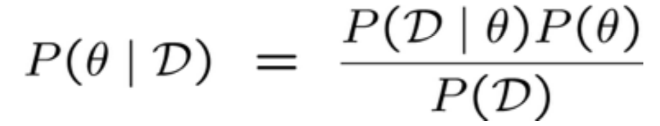
Our “magic” coin – prior probabilities
Back to our coin, let’s say a friend insists that the coin isn’t magic and that it’s just a regular coin
  The prior probability will be quite low (say, 10%), as your friend thinks p(heads) is 0.5
  So, p(θ = 0.5) = 0.1, but p(θ = 0.5|D) very much does not
    Imagine that your D is HHHHHHTHHHHHHHHHHH, is p(θ = 0.5|D) 0.5?

Slide 9
Our “magic” coin – p(θ|D)
What should our hypothesis of p(H) be given our (training) data?
Well, how about the Maximum a posteriori (MAP) probability, which is the mode of the posterior distribution (or the most likely single value)

Slide 10
Our “magic” coin – p(θ|D)
What should our hypothesis of p(H) be given our (training) data?
Well, how about the Maximum a posteriori (MAP) probability, which is the mode of the posterior distribution (or the most likely single value)
  That is, select your θ such that p(θ|D) is the highest possible value
  Similar in concept to MLE, different in that you’re constrained by prior knowledge (represented as the prior probability)
  Note that as your observed knowledge approaches infinity, your confidence in the prior probability goes to zero (the prior is useless if you’re given the answer)
  This means that Bayes is most useful when you have a good prior and/or a small amount of training data

Slide 11
Our “magic” coin – using numbers
Say we have the observations HHTHT
Select θ to be 0.1 (because, why not?)
p(θ|HHTHT) = [p(HHTHT|θ) * p(θ)] / p(HHTHT)
p(θ|HHTHT) α [[0.1*0.1*0.9*0.1*0.9] * ???]
p(θ|HHTHT) α 0.00081

Slide 12
Our “magic” coin – using numbers
Say we have the observations HHTHT
Select θ to be 0.6 (because, that’s probably better)
p(θ|HHTHT) α [p(HHTHT|θ) * p(θ)]
p(θ|HHTHT) α [[0.6*0.6*0.4*0.6*0.4] * ???]
p(θ|HHTHT) α 0.03456 * ???

Slide 13
Our “magic” coin – using numbers
Say we have the observations HHTHT
Select θ to be 0.5 (to finish off)
p(θ|HHTHT) α [p(HHTHT|θ) * p(θ)]
p(θ|HHTHT) α [[0.5*0.5*0.5*0.5*0.5] * ???]
p(θ|HHTHT) α 0.03125 * ???

Slide 14
Lecture 5: Bayesian Inference & Regression

Slide 15
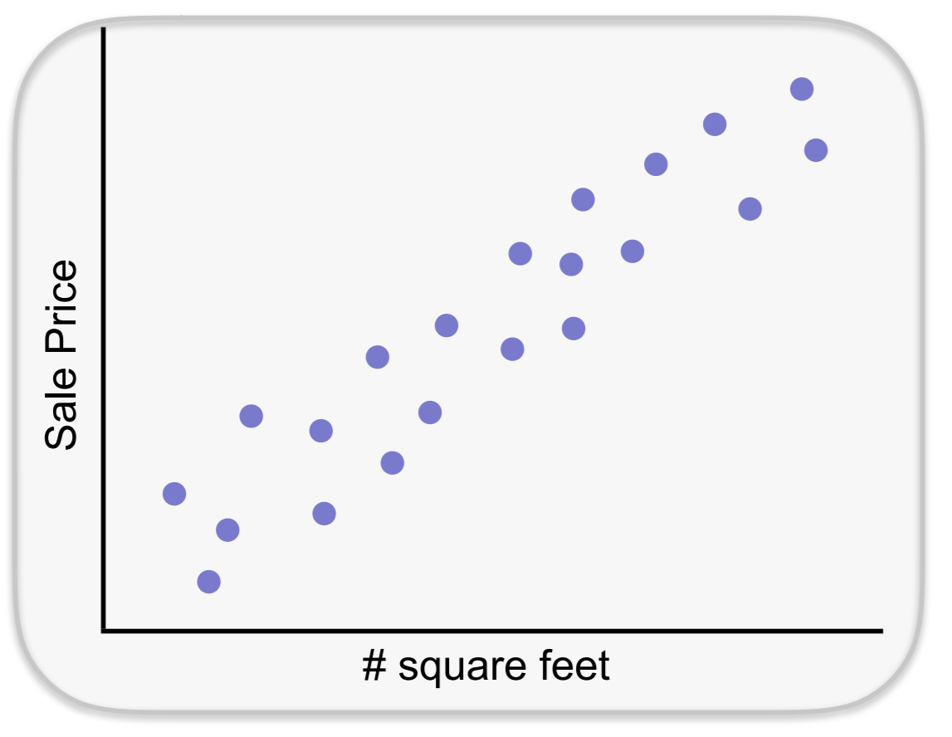
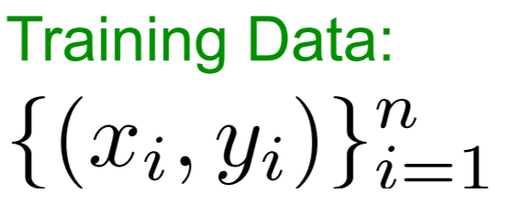
An example regression problem
Zillow.com – a website that tracks houses for sale & rent
Given the sales data available, predict what a house will sell for
y = house sales based on…
X = square footage, zip code, date of sale, etc., etc.

Slide 16
Basis of regression
Useful when you have variables that are related in a nondeterministic manner (ex: house price and square footage)
We observe a dependent variable (home price)
For each dependent variable, we observe predictors (square footage)
Our goal is to determine the relationship between the dependent variables and predictors
Note: Dependent variables sometimes called “response(s),” predictors sometimes called “regressor(s)”

Slide 17
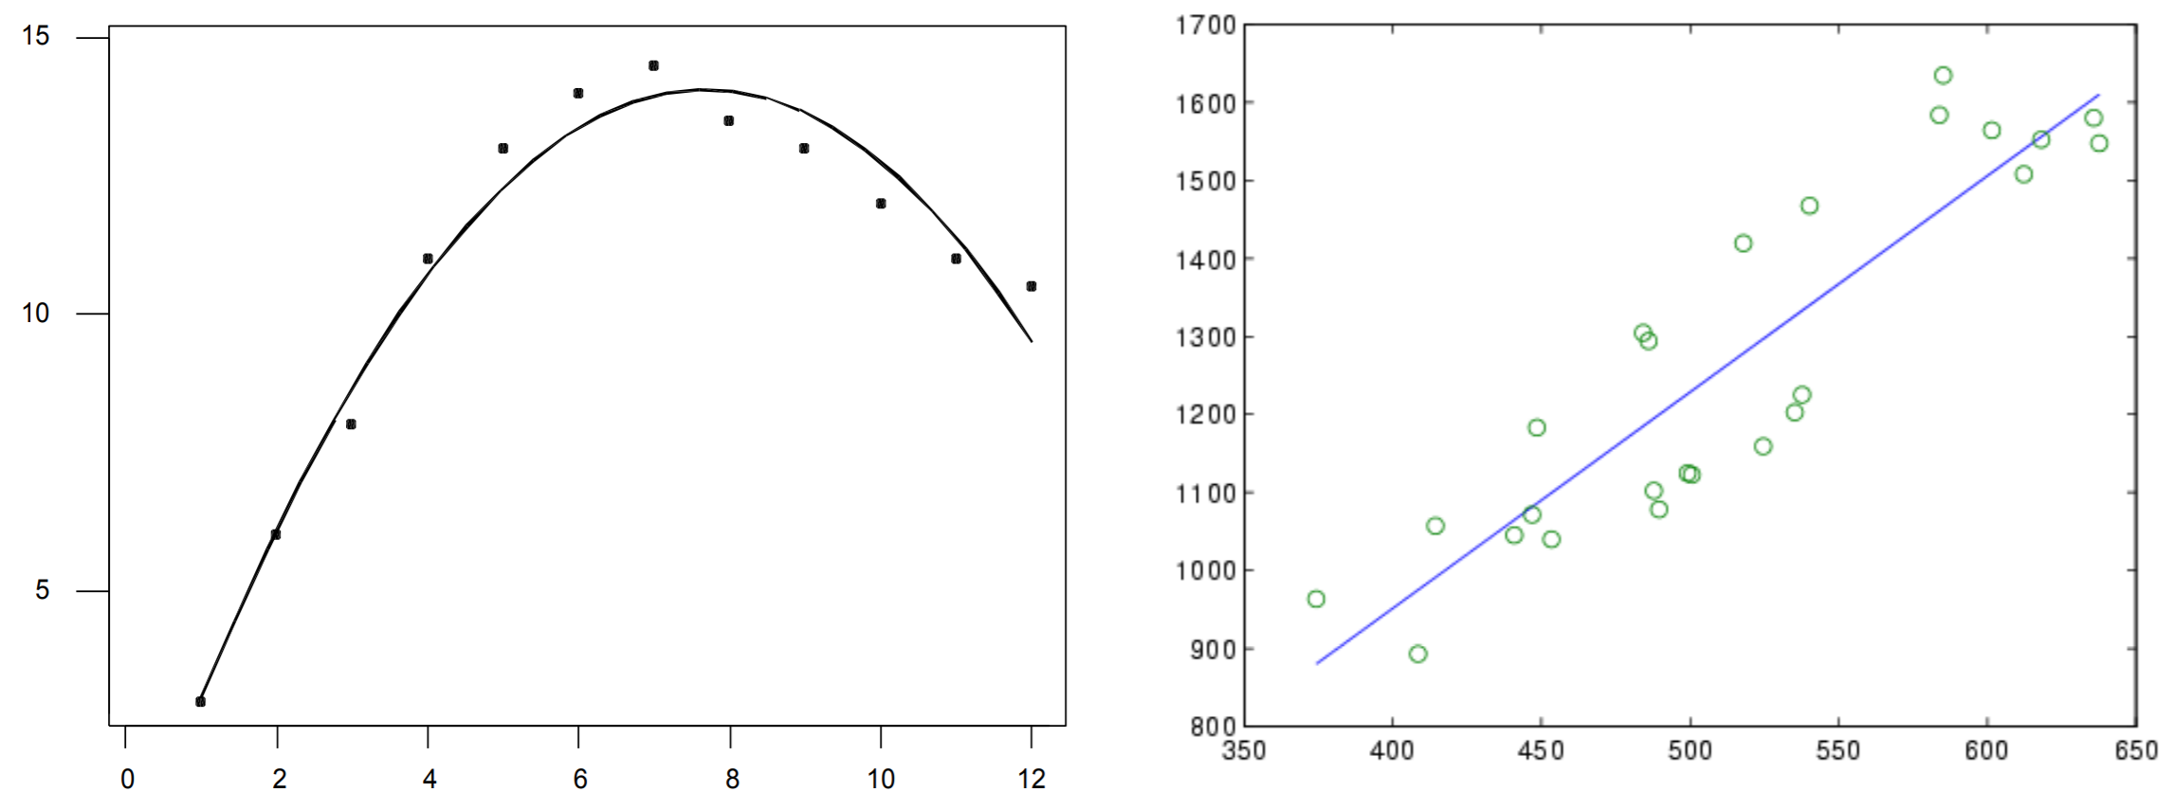
Aside: doesn’t need to be linear regression
Functions can be (and often are) non-linear
In this course we will focus on linear regression (other than the next slide) since we’re not going to be spending a lot of time on regression in general

Slide 18
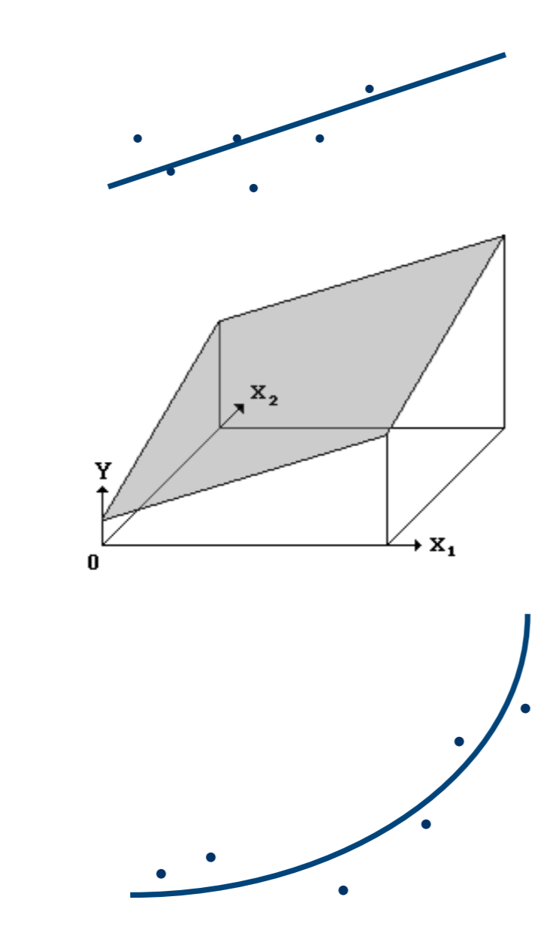
Aside: doesn’t need to be linear regression
Simple linear regression:
  Y = B₀ + B₁X + error
Multiple linear regression:
  Y = B₀ + B₁X₁ + B₂X₂ + error
Polynomial regression:
  Y = B₀ + B₁X + B₂X² + error

Slide 19
Linear regression
Our goal is to find B₀ and B₁ where
  Y = B₀ + B₁X + error
So we need to find:
  The intercept, B₀
  The slope of the line, B₁
Basic idea (which we’ll complicate in a minute):
  Plot the observations (like a scatter plot)
  Find the line that best “fits” or follows the plotted points

Slide 20
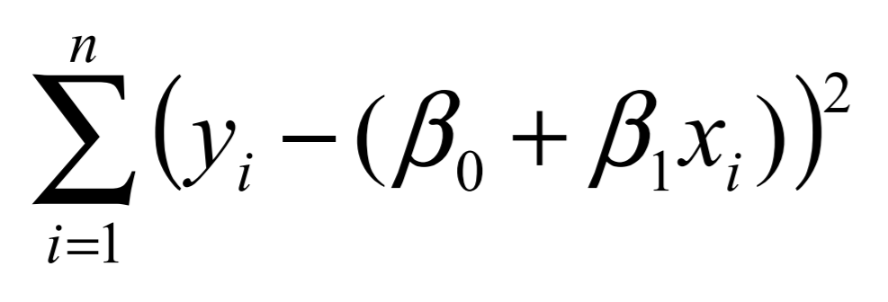
Estimating regression parameters
To estimate B₀ and B₁, you want to find the values that minimize the error (specifically, the squared error)
For observations 1, 2, 3, … i,-1 i, i+1, …, n, minimize:

Slide 21
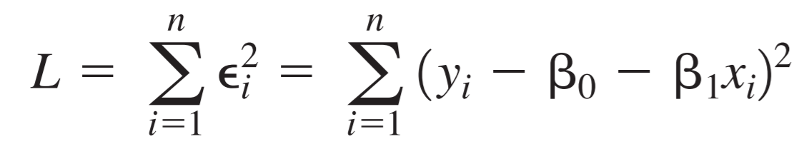
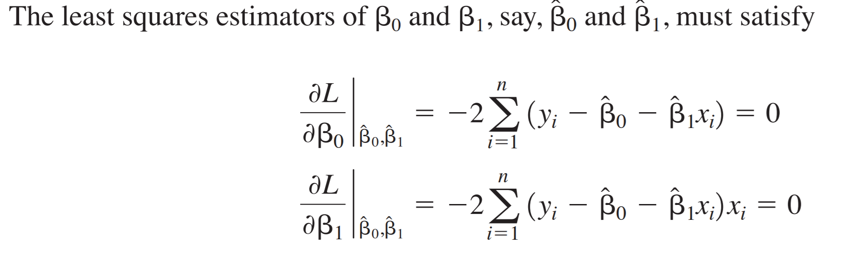
Least squares (minimizing squared error)
Minimize the squared error:

Slide 22
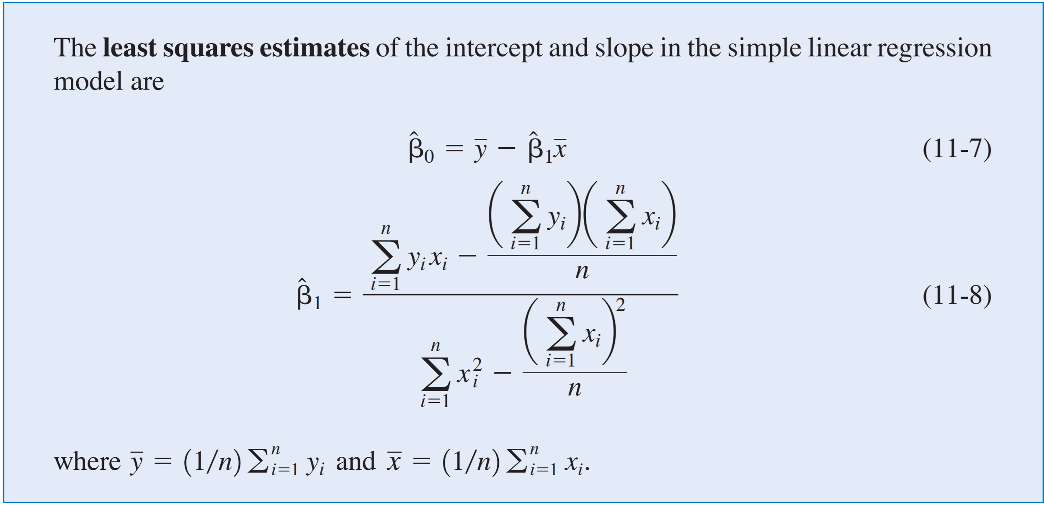
Least squares (minimizing squared error)

Slide 23
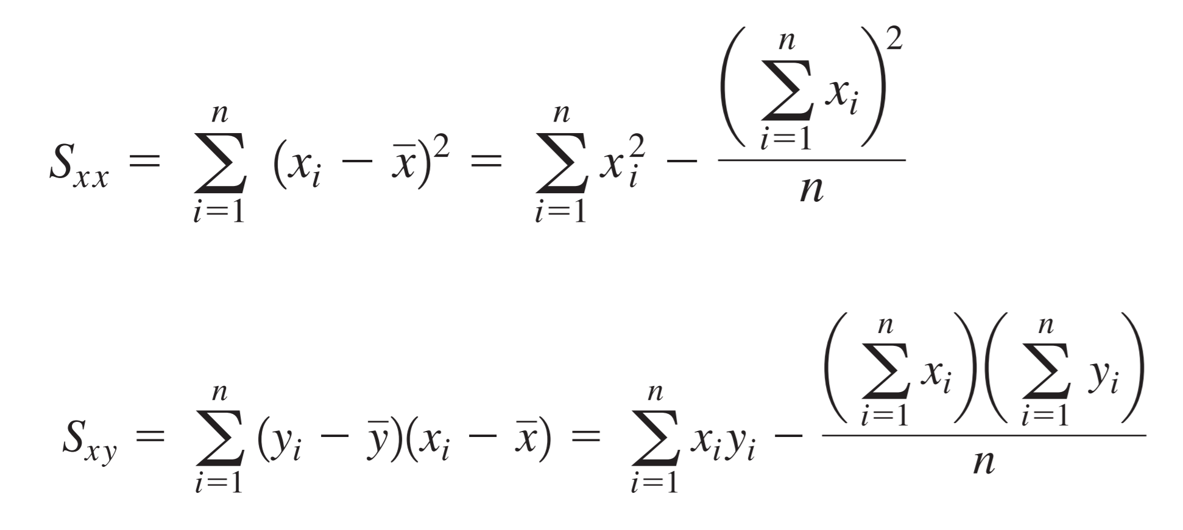
A notation that you might see…

Slide 24
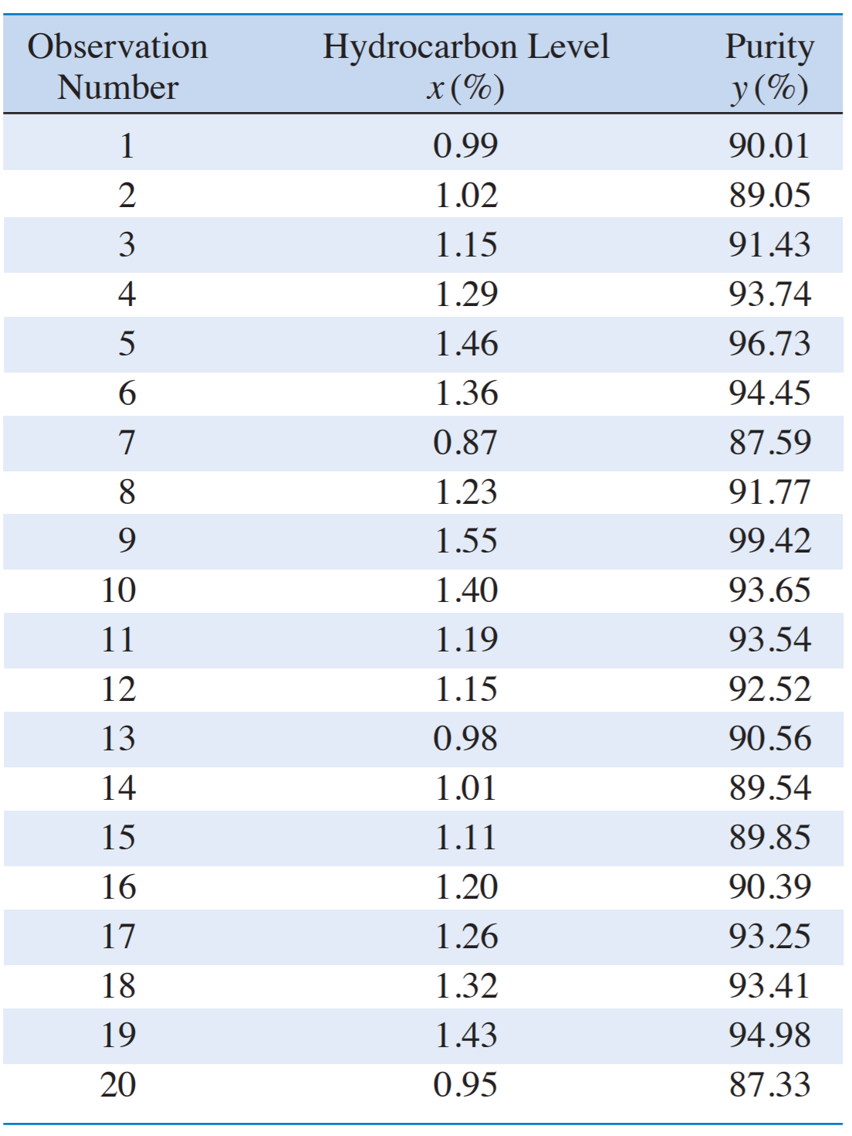
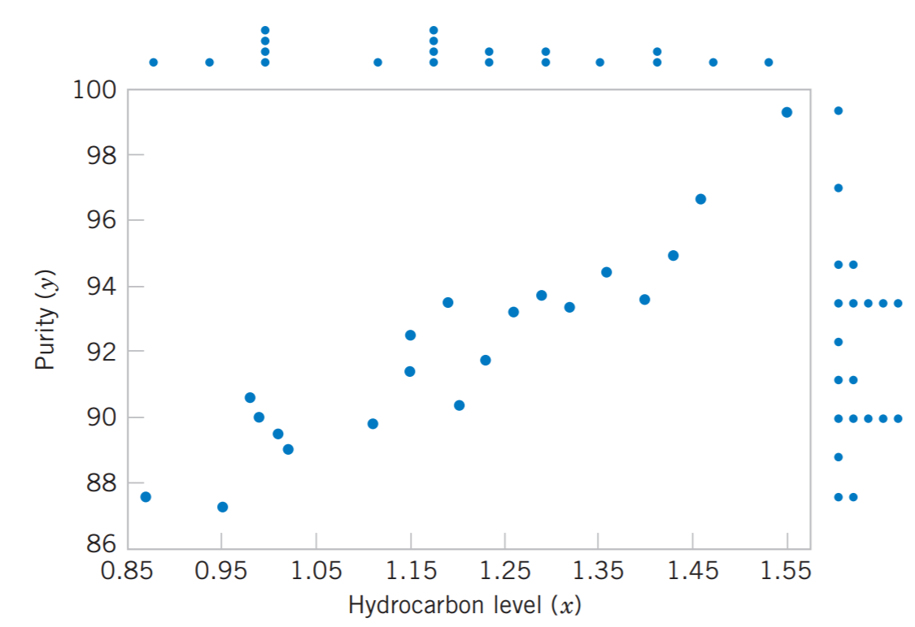
Example: oxygen and hydrocarbon levels

Slide 25
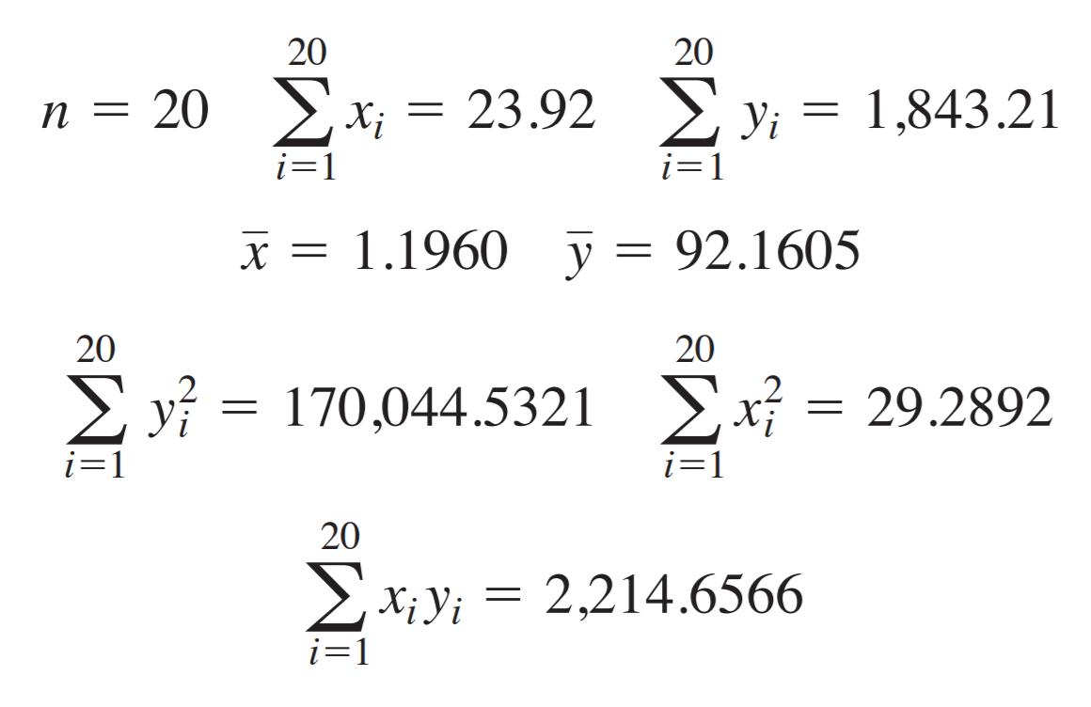
Example: oxygen and hydrocarbon levels

Slide 26
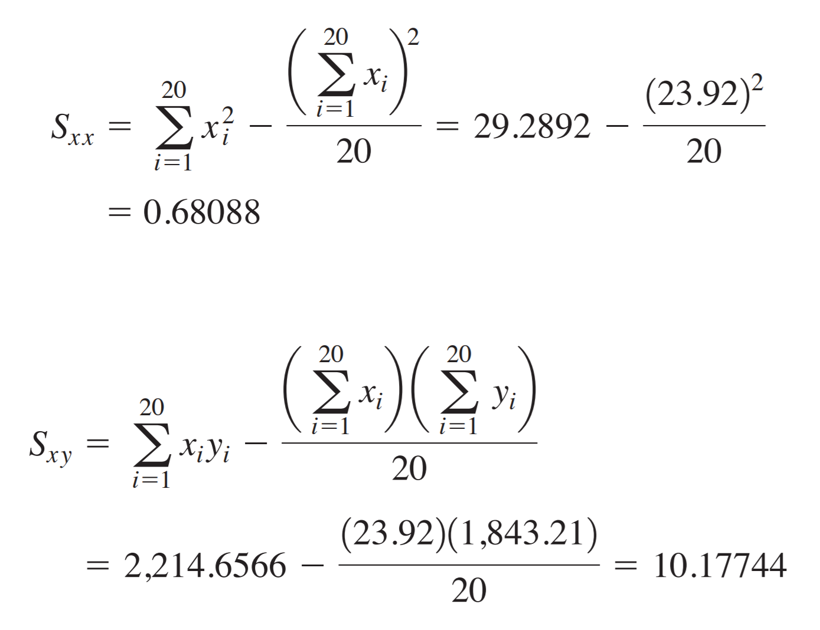
Example: oxygen and hydrocarbon levels

Slide 27
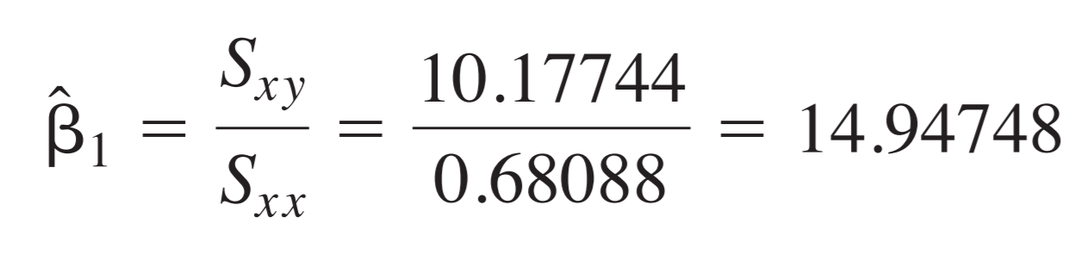
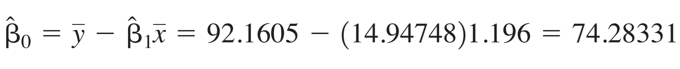
Example: oxygen and hydrocarbon levels

Slide 28
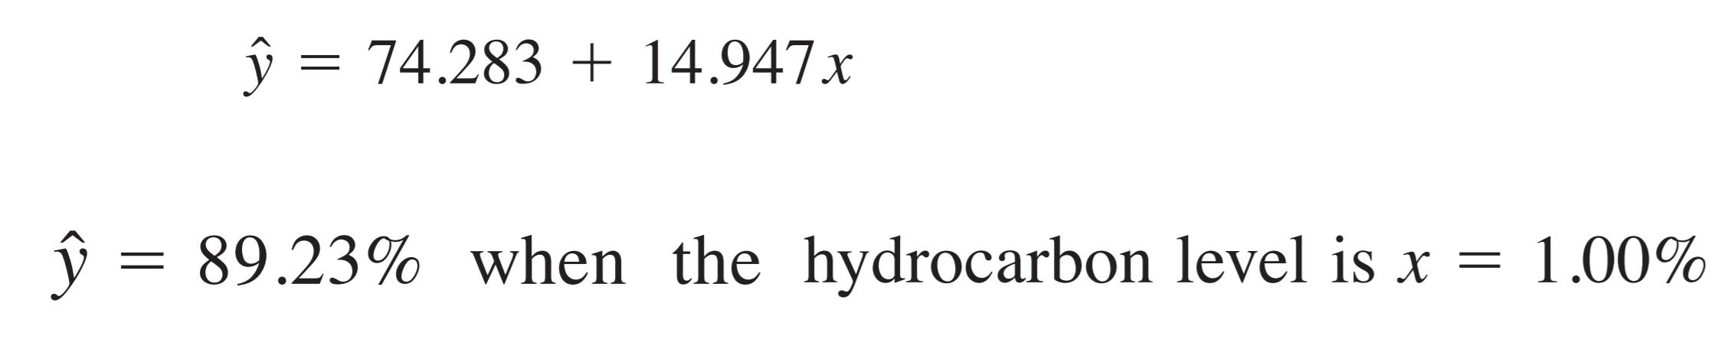
Example interpretation

